Slide 1


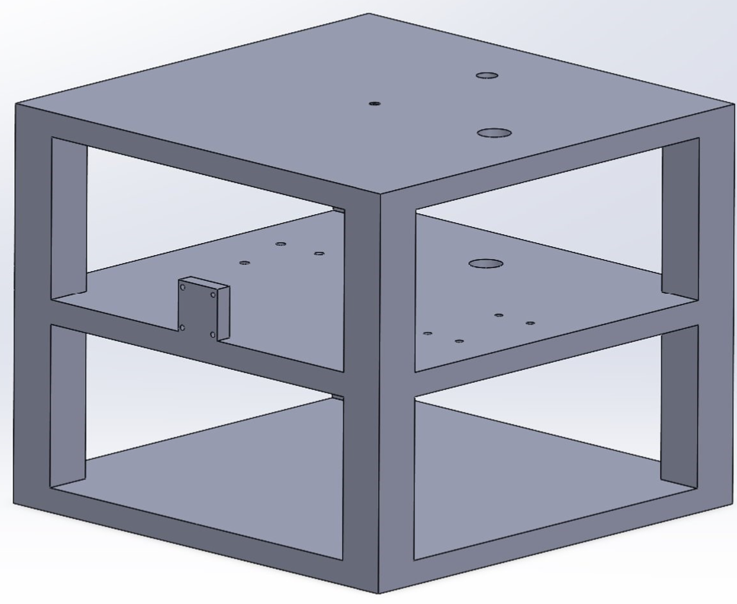
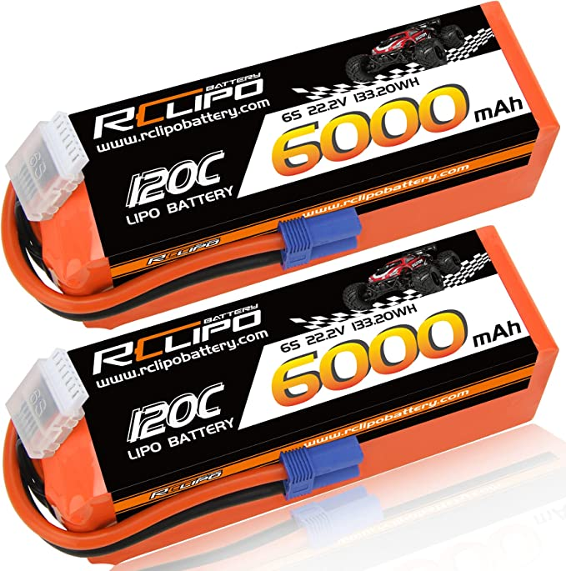
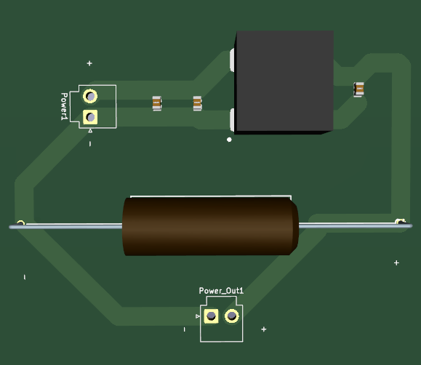
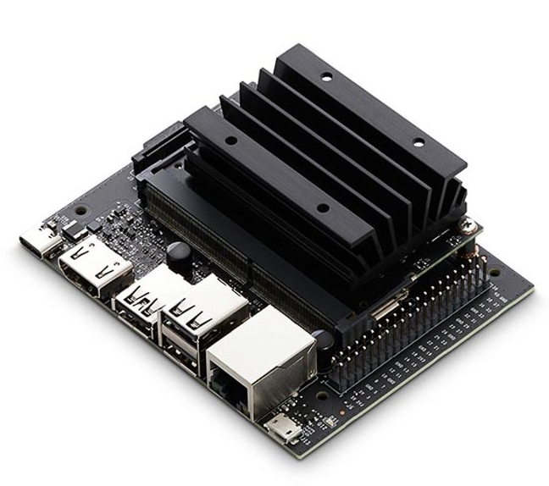
Robot Cognition Platform Sponsor: Bill Michael Advisor: Leslie Tekamp Khaled Almathkour, Makya Geist-Delgado, Tristan Lee, Angela Tran
Requirements
Must weigh less than 5kg Sensors
LiDAR (Point-Cloud Dada)
GPS (Location Data)
Camera (Visual Data)
IMU (Inertial Data)
The platform will use a Jetson Nano to process and run all sensors.
Design
Three-tiered design with mounting points for each sensor
PCB and DC/DC Power converters used to power peripherals
Design
All peripherals are powered by a 6s-12 LiPo Battery connected using EC5, providing 5V at 2A to the Jetson Nano and 12V at 3A to the LiDAR. Other Sensors are powered by the Nano.
Requirement​​ | ​​
Power Supply​​ | 18-48V​​
Peripherals​​ | GPS, IMU, LIDAR, Camera​​
Power Output ​​ | 5VDC at 10A​​
Power Output​​ | 3.3VDC at 10A​​
Power Output​​ | 12VDC at 5A​​
Generates​​ | Point-cloud data, spatial and image data, location data​​
Collects ​​ | Accurate geo positioning, image and video collection, attitude and gyroscope data, inertial data​​
Glossary
LiDAR: Light Detection and Ranging
GPS: Global Positioning System
IMU: Inertial Measurement Unit
PCB: Printed Circuit Board
LiPo: Lithium Polymer
Team Toucan

